Slide 1
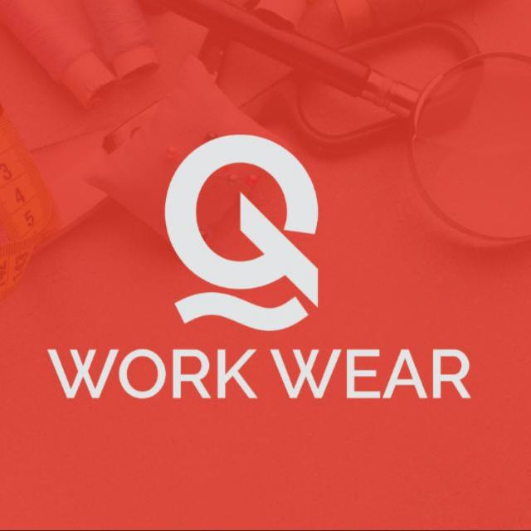
Business Portfolio

Slide 2
About Q workwear
Q Workwear is a local uniforms manufacturer tailored to all industry, sectors and working environments from events to industrial workwear. We offer a wide range of uniform solutions for commercial offices, construction industry, tradesmen, hospitality sector, schools, teams and many more.
Providing good quality and durable workwear makes us your ideal number one choice in the industry.

Slide 3
Our mission
Provide high quality equipment that is tailored to give you a safety, comfort and confidence at a competitive price to make sure people and workspaces are safe and healthy.
Our core values
- Integrity
- Realistic
- Efficient responsibility

Slide 4
Product range

Slide 5
Q workwear offer several types of workwear, and the specific types of workwear needed will depend on the industry, job tasks, and safety requirements. Here are some common types of workwear
Uniforms: Required in industries such as hospitality, healthcare, and public safety. Uniforms help to identify employees and create a professional image for the company.
Protective gear: Items such as safety glasses, hard hats, gloves, and safety shoes. Protective gear is essential for industries such as construction, manufacturing, and oil and gas.

Slide 6
Protective clothing: This type of workwear is designed to protect employees from various hazards, such as chemicals, extreme temperatures, and flames. Examples include lab coats, coveralls, and flame-resistant clothing.
At Q Workwear, we understand the importance of presenting a unified and professional image. Our commitment to quality craftsmanship, personalized branding, and industry-specific designs sets us apart. Each garment is crafted with attention to detail, ensuring both comfort and functionality.

Slide 7
Front Desk and Corporates

Slide 8
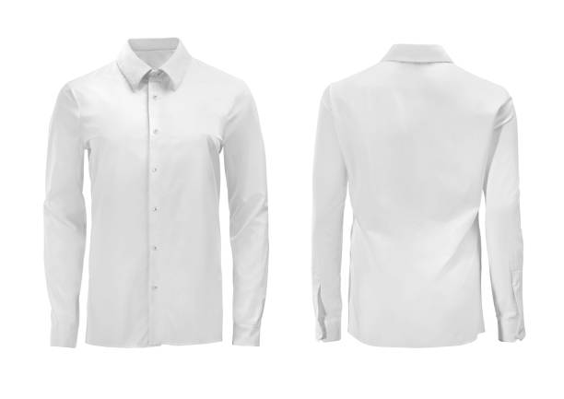

Slide 9
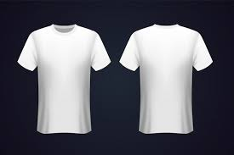
Uniforms contribute to a consistent brand image, helping to establish a recognizable and reputable Company

Slide 10
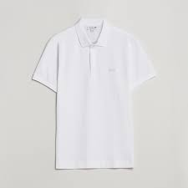
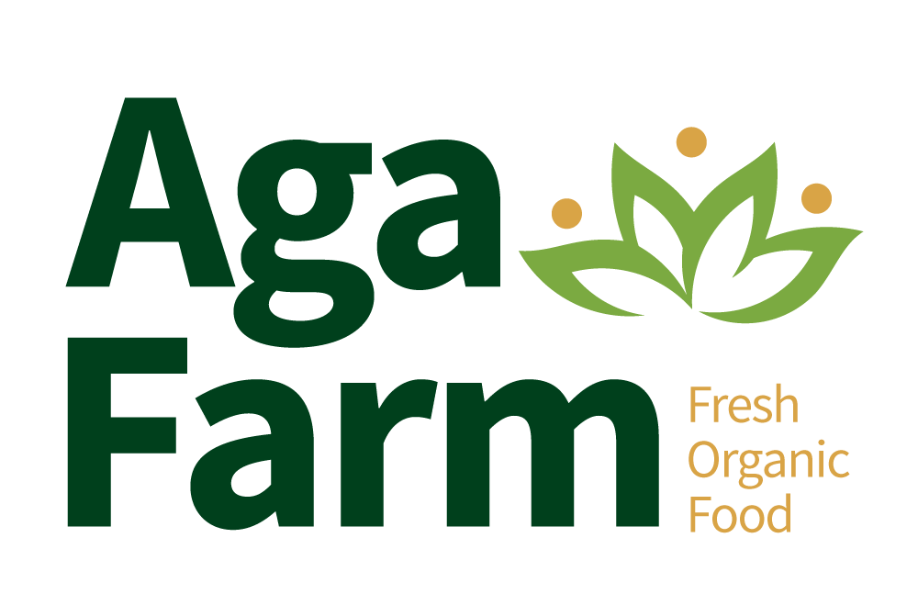
Uniform demonstrates a commitment to professionalism, reinforcing the idea that the staff takes their work seriously.

Slide 11
MEDICAL FIELD

Slide 12
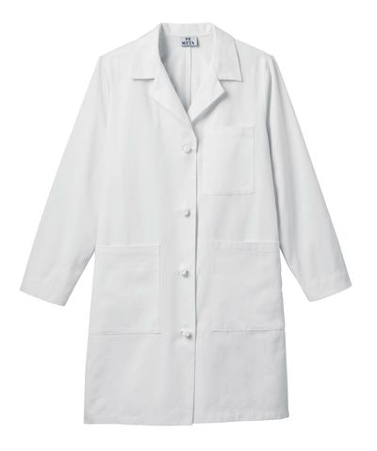
Dust coat suitable for field work in any sector

Slide 13
Uniform demonstrates a commitment to professionalism, reinforcing the idea that the staff takes their work seriously.

Slide 14
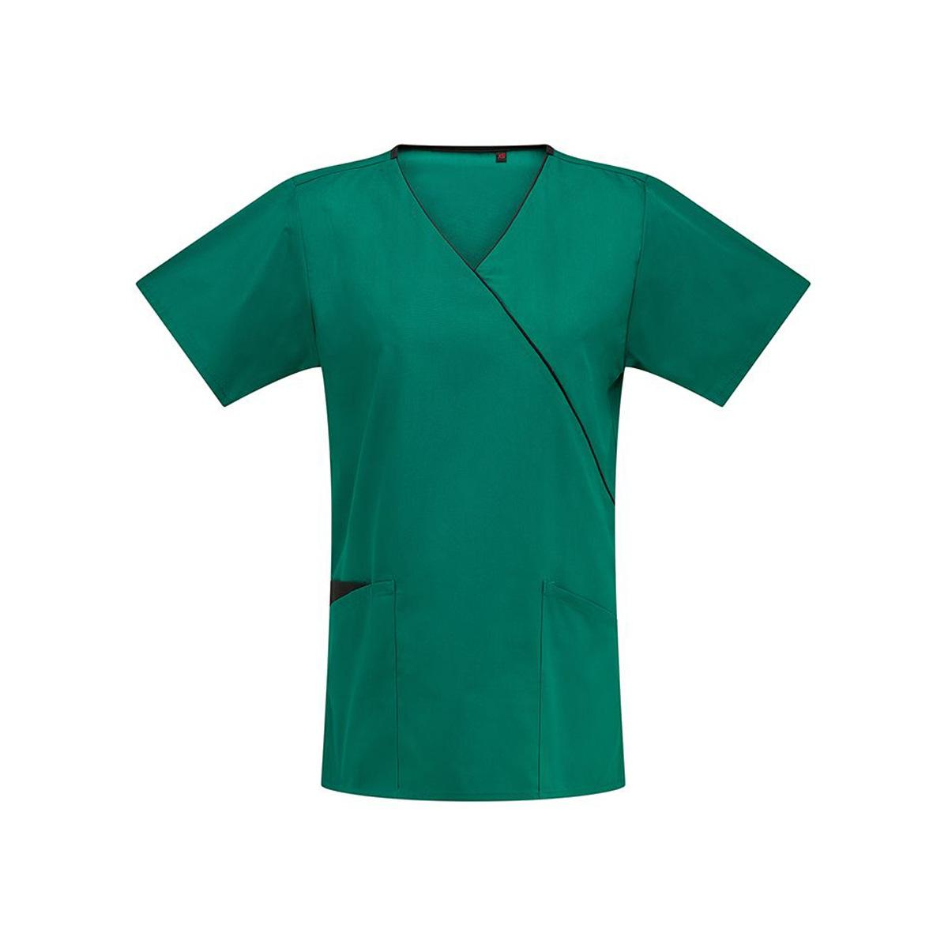
Medical Tunic

Slide 15
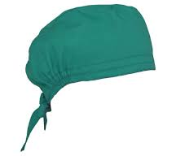
Surgeon Hat

Slide 16
Factory,Technical Field and Agriculture

Slide 17
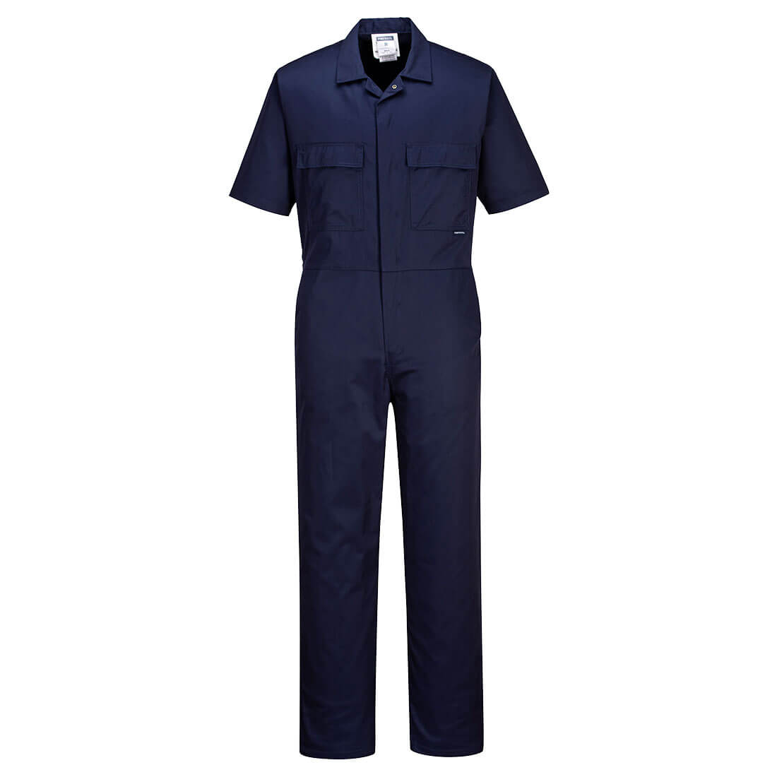
Overalls is a professional clothing whose primary function is to protect workers. It is a tracksuit to put on over clothes and was originally used to protect against dirt of all kinds.

Slide 18
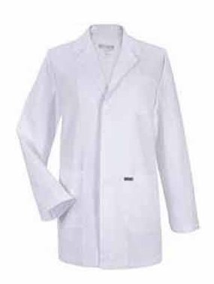
A light coat worn to protect clothing from substances used while working in a Factory

Slide 20
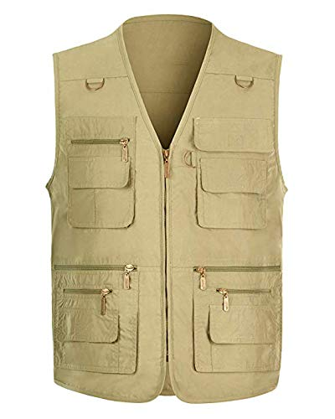
Westcoat used in various activities

Slide 21
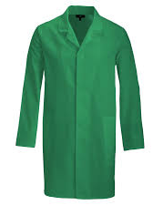

Slide 22
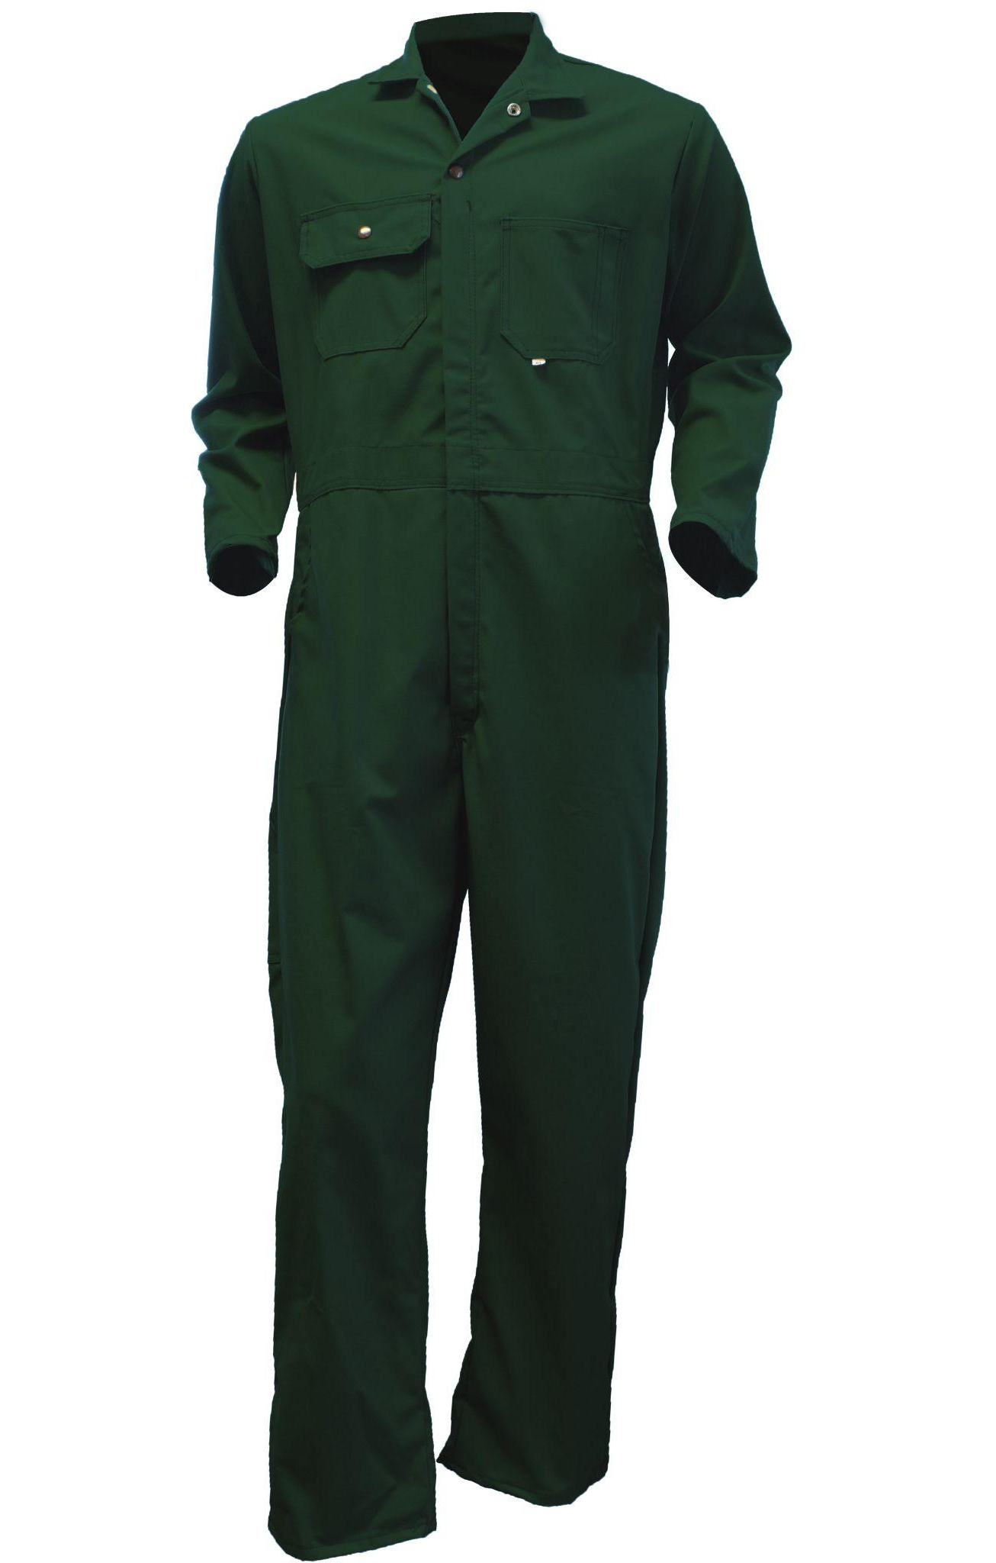

Slide 23
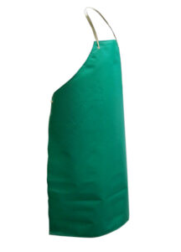
PVC Apron Provide durable and waterproof protection,perfect for various industrial and food processing environments

Slide 24
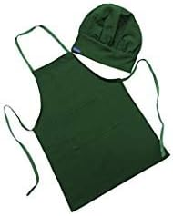

Slide 25
Sport Wear

Slide 26
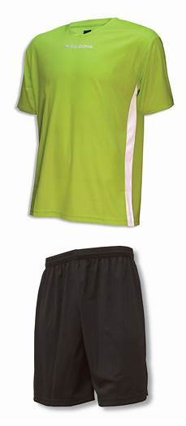
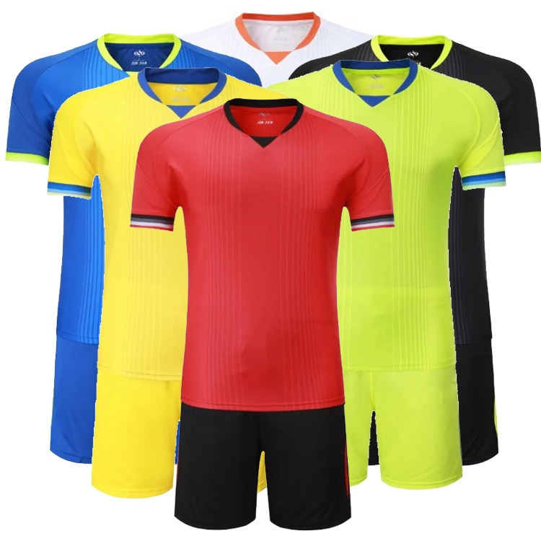

Slide 27
Personal Protective Equipment

Slide 28
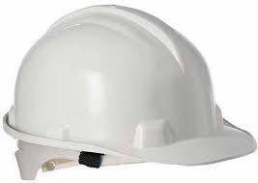
Protective head covering.

Slide 29
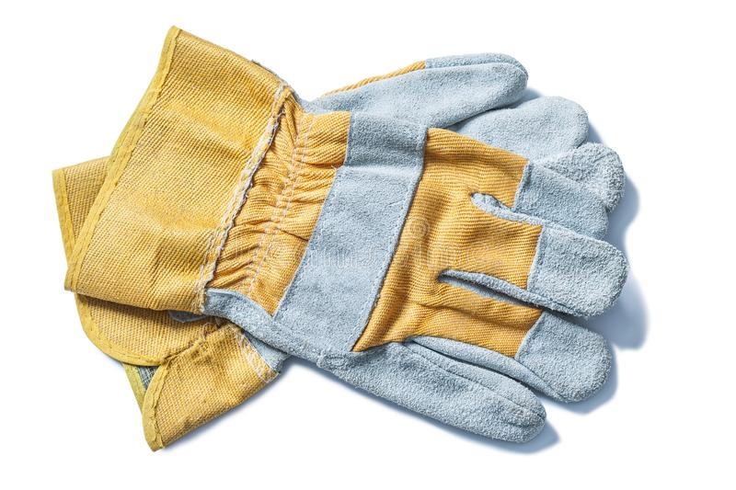
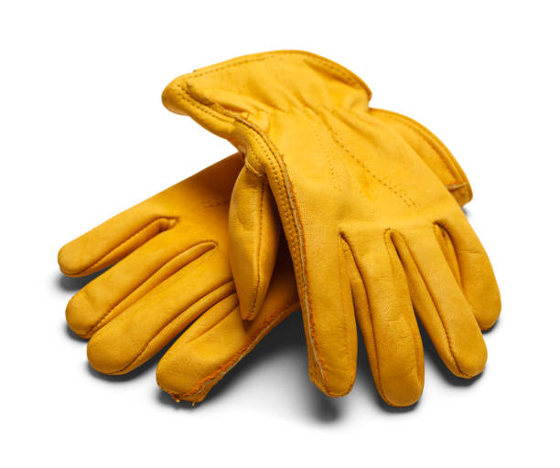
Gloves

Slide 30
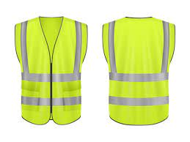
Reflective vest

Slide 31
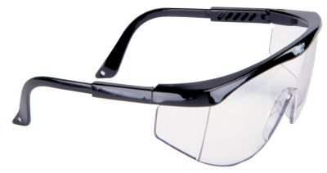
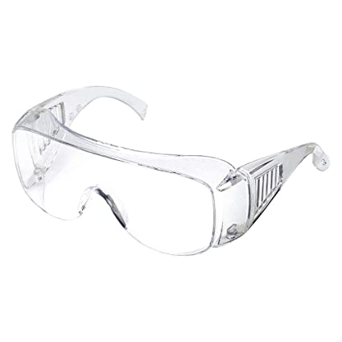
Eyes Wear

Slide 32
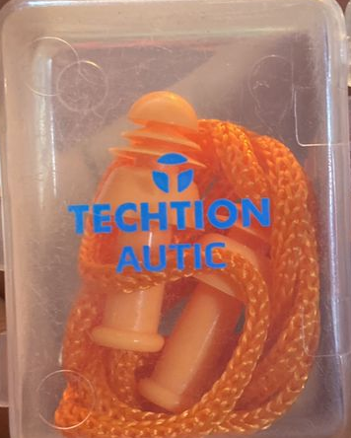
Create an environment where employees can perform their tasks without undue risk, resulting in fewer accidents.
This is not only protect the well-being of workers but also contributes to increase the productivity and a more positive work atmosphere

Slide 33
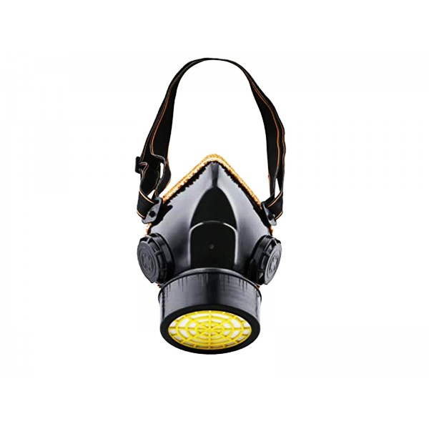
Create an environment where employees can perform their tasks without undue risk, resulting in fewer accidents.
This is not only protecting the well-being of workers but also contributes to increase the productivity and a more positive work atmosphere

Slide 34
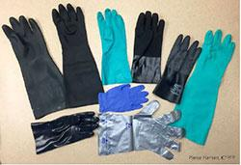
Create an environment where employees can perform their

Slide 35
Cleaning Uniform

Slide 36
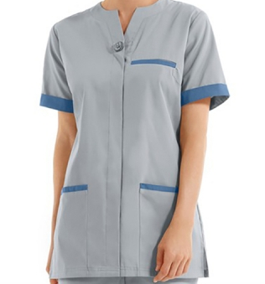
Uniforms foster a sense of unity among cleaning staff, promoting teamwork and a cohesive work environment

Slide 37
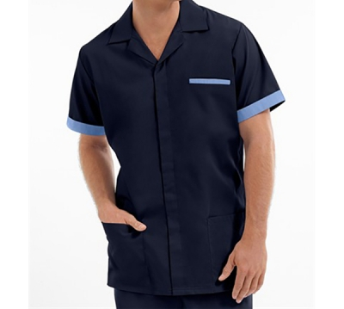
Uniforms foster a sense of unity among cleaning staff, promoting teamwork and a cohesive work environment

Slide 38
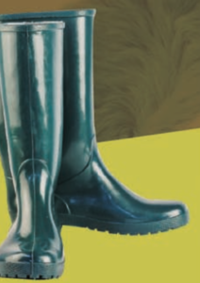
Gumboots provides protection from falling objects preventing one's feet from any damage, They provide prevention from burns, Slips, Trips, Fatigue and Fall. And are also benefiting for people working in hazardous areas like construction sites, oil or acid factories etc

Slide 39
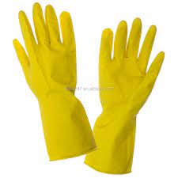
Latex gloves
Hygiene and Safety gloves are designed for specific work environments, promoting cleanliness and safety by providing appropriate attire for cleaning tasks.

Slide 40
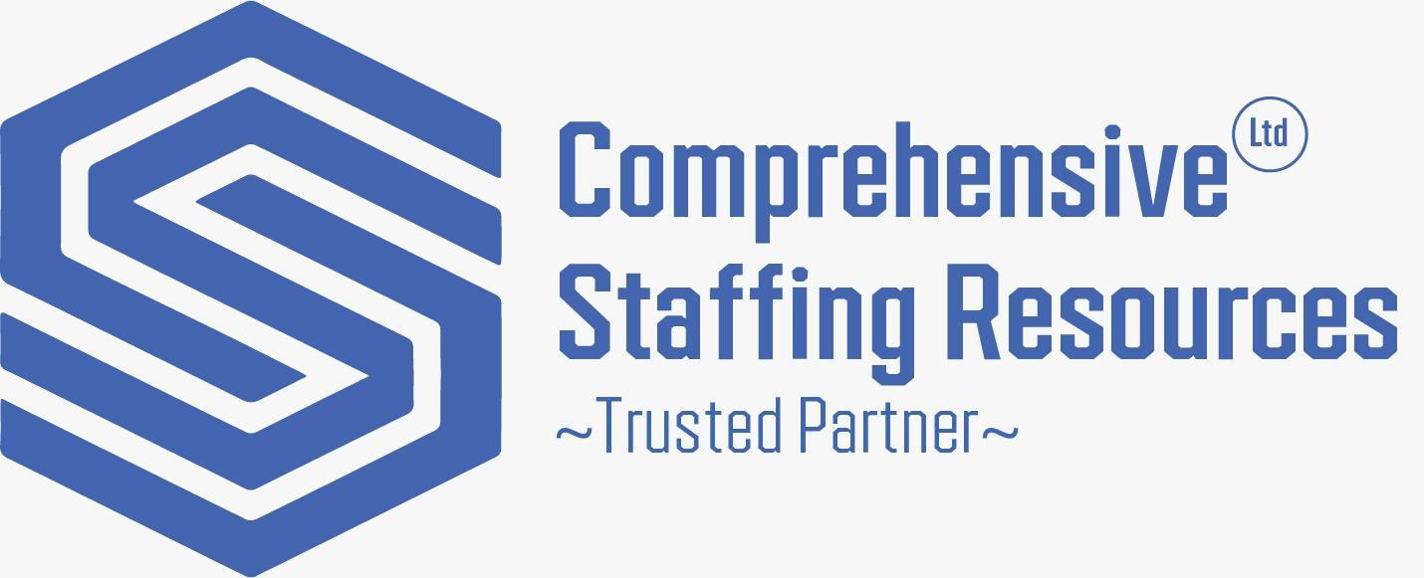

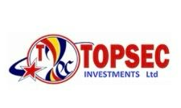

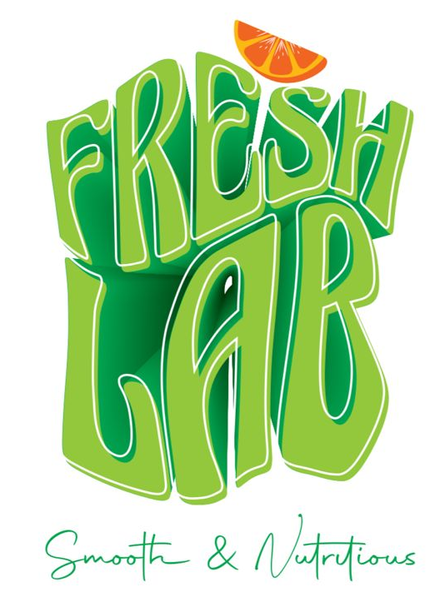
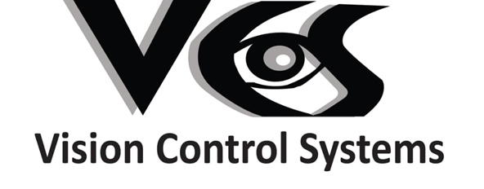


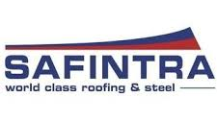

Our clients

Slide 41





Feel free to peruse for a closer look at our offerings. For a personalized consultation or to discuss your specific requirements, please don't hesitate to reach out. We look forward to the opportunity to collaborate and provide your team with the finest in custom-designed workwear
+250 782744231
workwear
qworkwearsolution@gmail.com
workwear
+250 788682940

Slide 42
Murakoze
WE HOPE TO DO BUSINESS WITH YOU

